Slide 1
Online Blood Donation System

Slide 2
Problem Statement
For any Healthcare Facility, it is very important to have the real-time updates of the Donors and stock availability and blood requirement. There have been repeated instances of issues reported in managing the donors’, recipients, Hospitals and camp records.
A Solution to track, manage the donors and the related information is critical to address the needs of the patients in any Healthcare facility.
Online blood bank system will bring a relief to most of the healthcare facilities by providing online application which will be easily accessible by any of the Donors, Doctors and Recipients at any time. With this application the Donors, Doctors and Recipients can search for Donors, Blood availability and blood requirement. They can also share their experience of donating blood to motivate Donors.

Slide 3
Roles
Name | Emp. Id. | Role
Abhishek Raj | 799190
Manoshi Nath | 799245
Satyajit Patil | 799226
Shreya Goyal | 799247
Tejashri Mate | 799215

Slide 4
Requirement
TECHNOLOGY: Java
HARDWARE: Desktop PC with 8GB RAM
SOFTWARE:
1.Node.js 10.15.1
2.Angular 5.0
3.Visual Studio Code 1.30
4.Eclipse IDE for Java EE Developers (Oxygen)
5.Maven 3.6.0
6.MySQL Community Server 8.0
7.MySQL Workbench 8.0.14

Slide 5
Flow diagrams
Data Flow Diagram (Level 0)
Data Flow Diagram Admin (Level 1)
Class Diagram

Slide 6
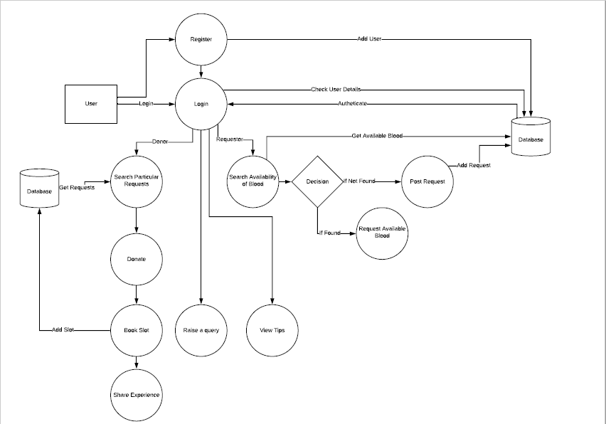

Slide 7
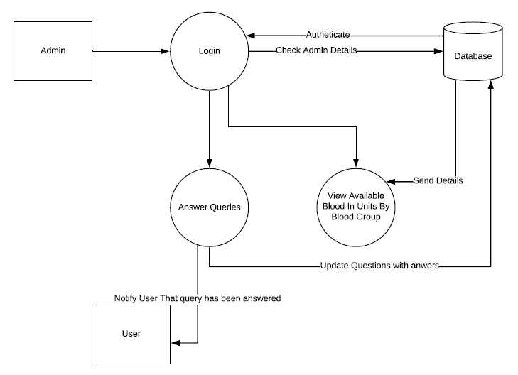

Slide 8
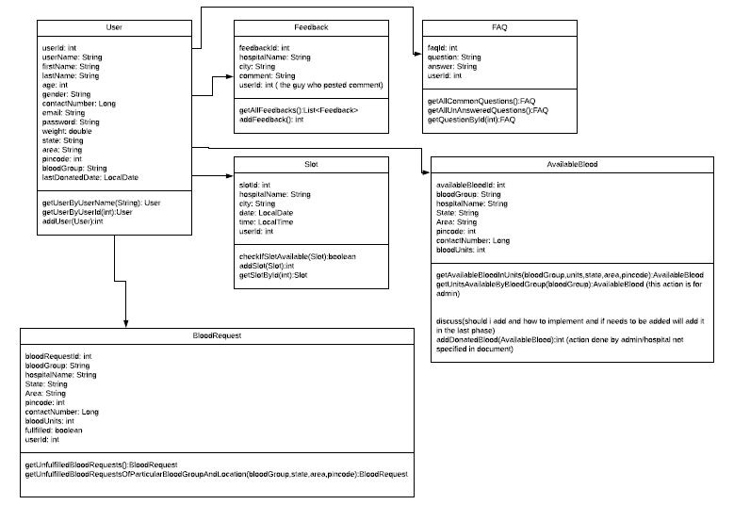

Slide 9
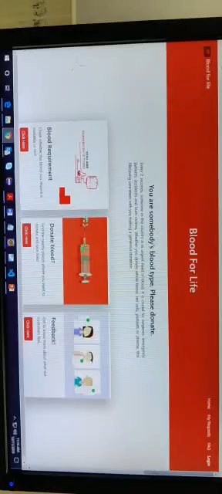
SnapShot
Home page:

Slide 11
Applications
This system consists of the process of how the requests from recipients for the required blood are served.
The Blood Bank first checks whether there are any requests and also checks the hospital’s database to ensure that the required amount of blood is available in that hospital for the request to be served.
The blood bank module also consists of requesting the blood when needed from the registered donors who are available.

Slide 12
CONCLUSION
The application can be used by the people interested in donating their blood by locating their nearest blood bank.
The web application provides a way of communication and synchronization between the hospitals and the blood banks.
The system is developed using Eclipse which is an open source software, while the web application for the hospitals and the blood banks is also developed using Visual Studio, hence the system developed is quite feasible.

